Slide 1

Detecting diabetic retinopathy in eye images
1
A seminar presentation
By
UTPAL KANT and ZAIN BASHIR
Université de Bourgogne

Slide 2
Table of Contents
Introduction
Diabetic Retinopathy
processing and augmenting
Deep Learning and CNN
Results
Proposed Model for Future Work
Conclusion
1

Slide 3
Introduction
This project aims to train a CNN with the diabetiec retinopathy images from EyePACS Database to generate a Classification model that classify Images as:
0 - No DR
1 - Mild
2 - Moderate
3 - Severe
4 - Proliferative DR

Slide 4
Problem, Data and Motivation
Motivation:
Affects ~100M, many in developed, ~45% of diabetics
Make process faster, assist ophthalmologist, self-help
Widespread disease, enable early diagnosis/care
Given fundus image
Rate severity of Diabetic Retinopathy
5 Classes: 0 (Normal), 1, 2, 3, 4 (Severe)
Hard classification (may solve as ordinal though)
Metric: quadratic weighted kappa, (pred – real)2 penalty

Slide 5
Diabetic Retinopathy
Diabetic retinopathy (DR) is the leading cause of blindness in the working-age population of the developed world and is estimated to affect over 93 million people.
The grading process consists of recognising very fine details, such as microaneurysms, to some bigger features, such as exudates, and sometimes their position relative to each other on images of the eye. (This is not an exhaustive list)

Slide 6
Challenges
High resolution images
Atypical in vision, GPU batch size issues
Discriminative features small
Grading criteria:
not clear (EyePACS guidelines)
learn from data
Incorrect labeling
Artifacts in ~40% images
Optimizing approach to QWK
Severe class imbalance
class 0 dominates
Too few training examples

Slide 7
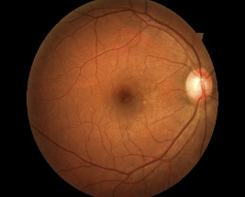
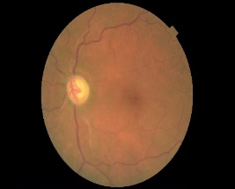
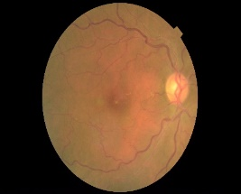
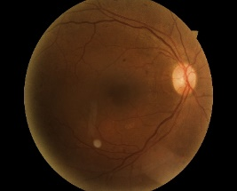
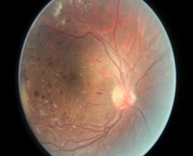
Data set
Data from EyePACS
~35,000 training images, ~54,000 test images
High resolution: variable, more than 2560 x 1920
Example image for each rating. (top row =0 1 and 2, bottom row = 3 and 4)
Notes:
Hadoop developed by Doug cutting and R developed by Ross Ihaka and Robert Gentleman and Jeffrey Dean and Sanjay Ghemawat GFS and MapReduce

Slide 8
PreProcessing
Cropping with certain probability
Color balance adjustment
Brightness adjustment
Contrast adjustment
Flipping images with 50% chance
Rotating images by x degrees, with x an integer in [0, 360[
Zooming (equal cropping on x and y dimensions)

Slide 9
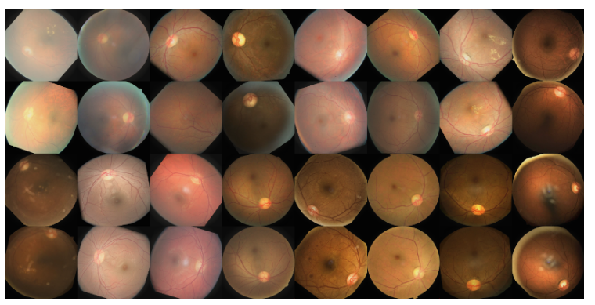
PreProcessing

Slide 10
Deep Learning
Basic Philosophy
Why Deep Learning
Deep Backpropagation
CNN – Convolutional Neural Networks
Unsupervised Preprocessing Networks
Stacked Auto Encoders
Deep Belief Networks
Deep Supervised Networks with managed gradient approaches
Deep Reinforcement Learning
Notes:
Pre-Traiining

Slide 11
Deep Net Feature Transformation
Supervised
Learning
ML Model
New Feature Space
Supervised
or
unsupervised
Learning
Original Features
Notes:
Can input both new and original spaces
Unsupervised pre-training

Slide 12
Deep Learning Overview
Train networks with many layers (vs. shallow nets with just a couple of layers)
Multiple layers work to build an improved feature space
First layer learns 1st order features (e.g. edges…)
2nd layer learns higher order features (combinations of first layer features, combinations of edges, etc.)
Some models learn in an unsupervised mode and discover general features of the input space – serving multiple tasks related to the unsupervised instances (image recognition, etc.)
Final layer of transformed features are fed into supervised layer(s)
And entire network is often subsequently tuned using supervised training of the entire net, using the initial weightings learned in the unsupervised phase

Slide 13
Convolutional Neural Networks
Niche networks built specifically for problems with low dimensional (e.g. 2-d) grid-like local structure
Character recognition – where neighboring pixels will have high correlations and local features (edges, corners, etc.), while distant pixels (features) are un-correlated
Natural images have the property of being stationary, meaning that the statistics of one part of the image are the same as any other part
Some biological plausibility from visual cortex
While standard NN nodes take input from all nodes in the previous layer, CNNs enforce that a node receives only a small set of features which are spatially or temporally close to each other called receptive fields from one layer to the next (e.g. 3x3, 5x5), thus enforcing ability to handle local 2-D structure.
Can find edges, corners, endpoints, etc.
Good for problems with local 2-D structure, but lousy for general learning with abstract features having no prescribed feature ordering or locality
Notes:
Exact position of detected feature not important, but the relative positions can be and can be captured by later layers
5x5, 4x4 common

Slide 14
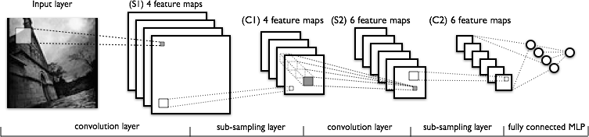
CNN Structure
Each node (e.g. convolution) is calculated for each receptive field in the previous layer
During training the corresponding weights are always tied to be the same (ala BPTT)
Thus a relatively small number of unique weight parameters to learn, although they are replicated many times in the feature map
Each node output in CNN is f(Σxw + b)
Multiple feature maps in each layer
Each feature map should learn a different translation invariant feature
Since after first layer, there are always multiple feature maps to connect to the next layer, it is a pre-made human decision as to which previous maps the current convolution map receives inputs from, could connect to all or a subset (S2 in figure below)
Convolution layer causes total number of features to increase
Notes:
Note increase in first convolution layer from initial image
Some models let each node have a unique (rather than shared) bias weight
Total features increase, but not the volume of any given feature map stays same (zero-padded) or decreases (save)

Slide 15
CNN Architecture
INPUT [64x64x3] will hold the raw pixel values of the image, an image of width 64, height 64, and with three color channels R,G,B.
CONV layer will compute the output of neurons that are connected to local regions in the input, each computing a dot product between their weights and a small region they are connected to in the input volume. This may result in volume such as [64x64x12] if we decided to use 12 filters.
RELU layer will apply an elementwise activation function, such as the max(0,x)max(0,x) thresholding at zero. This leaves the size of the volume unchanged ([64x64x12]).
POOL layer will perform a down sampling operation, resulting in volume such as [16x16x12].
FC (i.e. fully-connected) layer will compute the class scores, resulting in volume of size [1x1x5], where each of the 10 numbers correspond to a class score, such as among the 5 categories.
Notes:
Create “Grandmother” cells corresponding do different variants of the concept

Slide 16
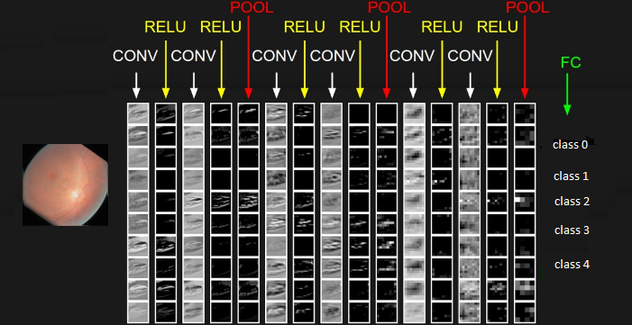
CNN Architecture
Notes:
Locally unique connections – Same map size but weights trained independently
Tiled convolution – neighbor node uses different kernel, but kernels repeat after some stride
Could have a stride value in each dimension

Slide 17
CNN Architecture
The activations of an example ConvNet architecture. The initial volume stores the raw image pixels and the last volume stores the class scores. Each volume of activations along the processing path is shown as a column. Since it's difficult to visualize 3D volumes, we lay out each volume's slices in rows. The last layer volume holds the scores for each class, but here we only visualize the sorted top 5 scores, and print the labels of each one
Notes:
Locally unique connections – Same map size but weights trained independently
Tiled convolution – neighbor node uses different kernel, but kernels repeat after some stride
Could have a stride value in each dimension

Slide 18
CNN Training
Trained with BP but with weight tying in each feature map
Randomized initial weights through entire network
Just average the weight updates over the tied weights in feature map layers
Convolution layer
Each feature map has one weight for each input and one bias
Thus a feature map with a 5x5 receptive field (filter) would have a total of 26 weights, which are the same coming into each node of the feature map
If a convolution layer had 10 feature maps, then only a total of 260 unique weights to be trained in that layer (much less than an arbitrary deep net layer without sharing)
Sub-Sampling (Pooling) Layer
All elements of receptive field max’d, averaged, summed, etc. Result multiplied by one trainable weight and a bias added, then passed through non-linear function (detector) for each pooling node
If a layer had 10 pooling feature maps, then 20 unique weights to be trained
While all weights are trained, the structure of the CNN is currently usually hand crafted with trial and error.
Number of total layers, number of receptive fields, size of receptive fields, size of sub-sampling (pooling) fields, which fields of the previous layer to connect to
Typically decrease size of feature maps and increase number of feature maps for later layers
Notes:
Note that pooling (size and function) are hand-crafted by the network designer, though there is a trainable weight and bias to “tune” the pooling
Or BP variant
Can use Local response normalization or variants – effort to have feature maps learn different features, but not essential
But standard BP already deals with that since trying to minimize errors and if all hidden nodes learned the same function, then would get lousy accuracy, with easy problem could duplicate, but then that is all right.
Usually need more maps in layers (100s…)

Slide 19
CNN Summary
High accuracy for image applications – Breaking all records and doing it using just using just raw pixel features!
Special purpose net – Just for images or problems with strong grid-like local spatial/temporal correlation
Once trained on one problem (e.g. vision) could use same net (often tuned) for a new similar problem – general creator of vision features
Unlike traditional nets, handles variable sized inputs
Same filters and weights, just convolve across different sized image and dynamically scale size of pooling regions (not # of nodes), to normalize
Different sized images, different length speech segments, etc.
Lots of hand crafting and CV tuning to find the right recipe of receptive fields, layer interconnections, etc.
Lots more Hyperparameters than standard nets, and even than other deep networks, since the structures of CNNs are more handcrafted
CNNs getting wider and deeper with speed-up techniques (e.g. GPU, ReLU, etc.) and lots of current research, excitement, and success
Notes:
Dynamic size – Pooling region just sums/maxes over an area with one final weight so no hard changes when we adjust pool region size
Simard 2003, Simple consistent CNN structure 5x5 with 2x2 subsampling with number of features 5 in first C-layer, 50 in next, until too small.
Don’t actually used pool layer as instead just connect every other node which samples rather than max/average.
Each layer reduces feature size by (n-3)/2. Just two layers for mnist.
They also use elastic distortions which is a type of jitter to get increased data. 99.6% - best at the time, Distortions also help a lot with standard MLP
Thus an approach with less Hyperparameter fiddling
Ciresan and Schmidhuber 2012, Multi column DNN. CNN with depth 6-10 (deeper if initial input image is bigger), and wider on fields, 1-2 hidden layers in MLP, columns are CNNs (an ensemble with different parameters, features, etc.) where their output is averaged, jitter inputs, multi-day GPU training, annealed LR (.001 dropping to .00003) 99.76% mnist

Slide 20
Experimental Results
We Applied CNN Network in using Tensorflow library in Python on small subset of EyePACS Data Base
Train Data: 150
Test Data: 90
Result: Accuracy on test data: 3.99%
Notes:
Dynamic size – Pooling region just sums/maxes over an area with one final weight so no hard changes when we adjust pool region size
Simard 2003, Simple consistent CNN structure 5x5 with 2x2 subsampling with number of features 5 in first C-layer, 50 in next, until too small.
Don’t actually used pool layer as instead just connect every other node which samples rather than max/average.
Each layer reduces feature size by (n-3)/2. Just two layers for mnist.
They also use elastic distortions which is a type of jitter to get increased data. 99.6% - best at the time, Distortions also help a lot with standard MLP
Thus an approach with less Hyperparameter fiddling
Ciresan and Schmidhuber 2012, Multi column DNN. CNN with depth 6-10 (deeper if initial input image is bigger), and wider on fields, 1-2 hidden layers in MLP, columns are CNNs (an ensemble with different parameters, features, etc.) where their output is averaged, jitter inputs, multi-day GPU training, annealed LR (.001 dropping to .00003) 99.76% mnist

Slide 21
Problem we Faced and Proposed Work
The Main Problem we faced is hardware requirement to generate the Classification Model
Proposed Solution : Parallel and Distributed Computing Using Hadoop Framework and PySpark
Notes:
Dynamic size – Pooling region just sums/maxes over an area with one final weight so no hard changes when we adjust pool region size
Simard 2003, Simple consistent CNN structure 5x5 with 2x2 subsampling with number of features 5 in first C-layer, 50 in next, until too small.
Don’t actually used pool layer as instead just connect every other node which samples rather than max/average.
Each layer reduces feature size by (n-3)/2. Just two layers for mnist.
They also use elastic distortions which is a type of jitter to get increased data. 99.6% - best at the time, Distortions also help a lot with standard MLP
Thus an approach with less Hyperparameter fiddling
Ciresan and Schmidhuber 2012, Multi column DNN. CNN with depth 6-10 (deeper if initial input image is bigger), and wider on fields, 1-2 hidden layers in MLP, columns are CNNs (an ensemble with different parameters, features, etc.) where their output is averaged, jitter inputs, multi-day GPU training, annealed LR (.001 dropping to .00003) 99.76% mnist

Slide 22
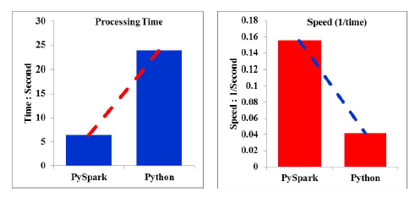
Big Data Spark Solution for Functional Magnetic Resonance Imaging
The processing time and speed comparison shows PySpark-based pipeline performs faster.
Ref: Saman Sarraf and Mehdi Ostadhashem. “Big data application in functional magnetic resonance imaging using apache spark”, IEEE Future Technologies Conference (FTC), 2016.

Slide 23
Conclusion
Much recent excitement, still much to be discovered
Impressive results
More work needed to understand how and why deep learning works so well – How deep should we go?
Potential for significant improvements
Works well in structured/Markovian spaces - CNNs, etc.
Important research question: To what extent can we use Deep Learning in arbitrary feature spaces?
Recent deep learning with supervised learning and extended BP approaches show huge potential in this area

Slide 24

Thank You

